Slide 1

Treasure Hunting in Virtual Appliances
Jeremy xgermx Galloway

Slide 2
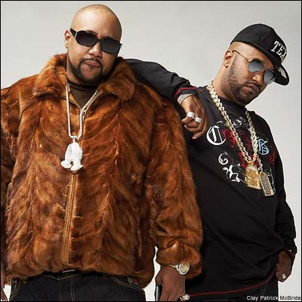
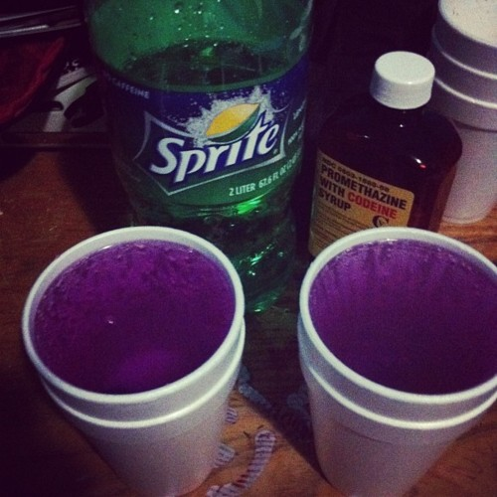
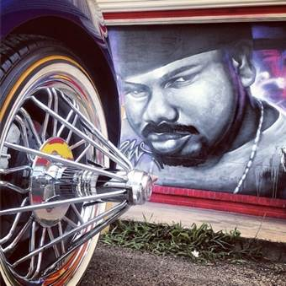
uname -a
Jeremy xgermx Galloway
Home subnet ffff:430a:101/128

Slide 3



uname -a
Jeremy xgermx Galloway
Hacking since the early 00’s
Got a few college degrees
Got a bunch of certs I don’t respect
LOLAPT0 Do you even have to ASCII <3 666 <3

Slide 4
uname -a
Jeremy xgermx Galloway
I spend most of my time thinking about:
State Sponsored Hacking
OPSEC • Anonymity • Privacy
Intelligence • Malware • Darknets
Online Censorship • Cyber-Crime
Pen-Testing • Incident-Response
Forensics • Web Security
Beyoncé

Slide 5
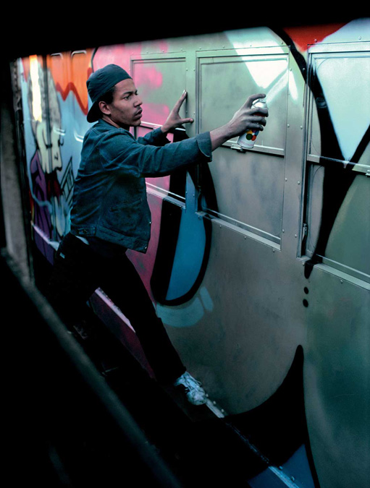


uname -a
Jeremy xgermx Galloway
…and when I’m /AFK

Slide 6
Abstract
FUD&
BULLSHIT&
NAMEDROP&
POPCULTURE&
SECURITY.

Slide 7
Abstract
Vendors distributing Virtual Appliances don’t “clean their tracks” == SLOPSEC
Mostly useless/boring configuration shite, but sometime they leave behind sensitive info AKA treasure
My approach: ½ Post Exploitation ½ Forensics
There are no secrets on the client side!
so you bes’ CYA ☺

Slide 8
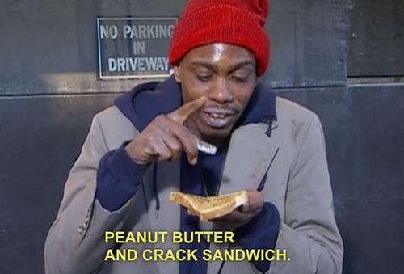
Wait, why?
No CVEs or Bug Bounties == !$

Slide 9
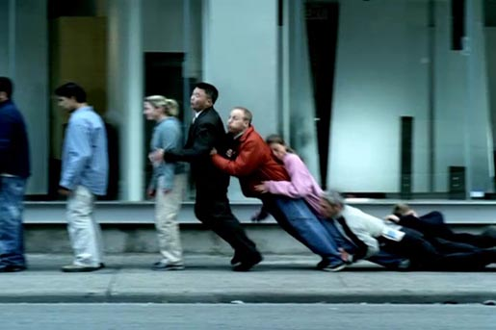
Wait, why?
No CVEs or Bug Bounties == !$
Pwn one, pwn them all

Slide 10
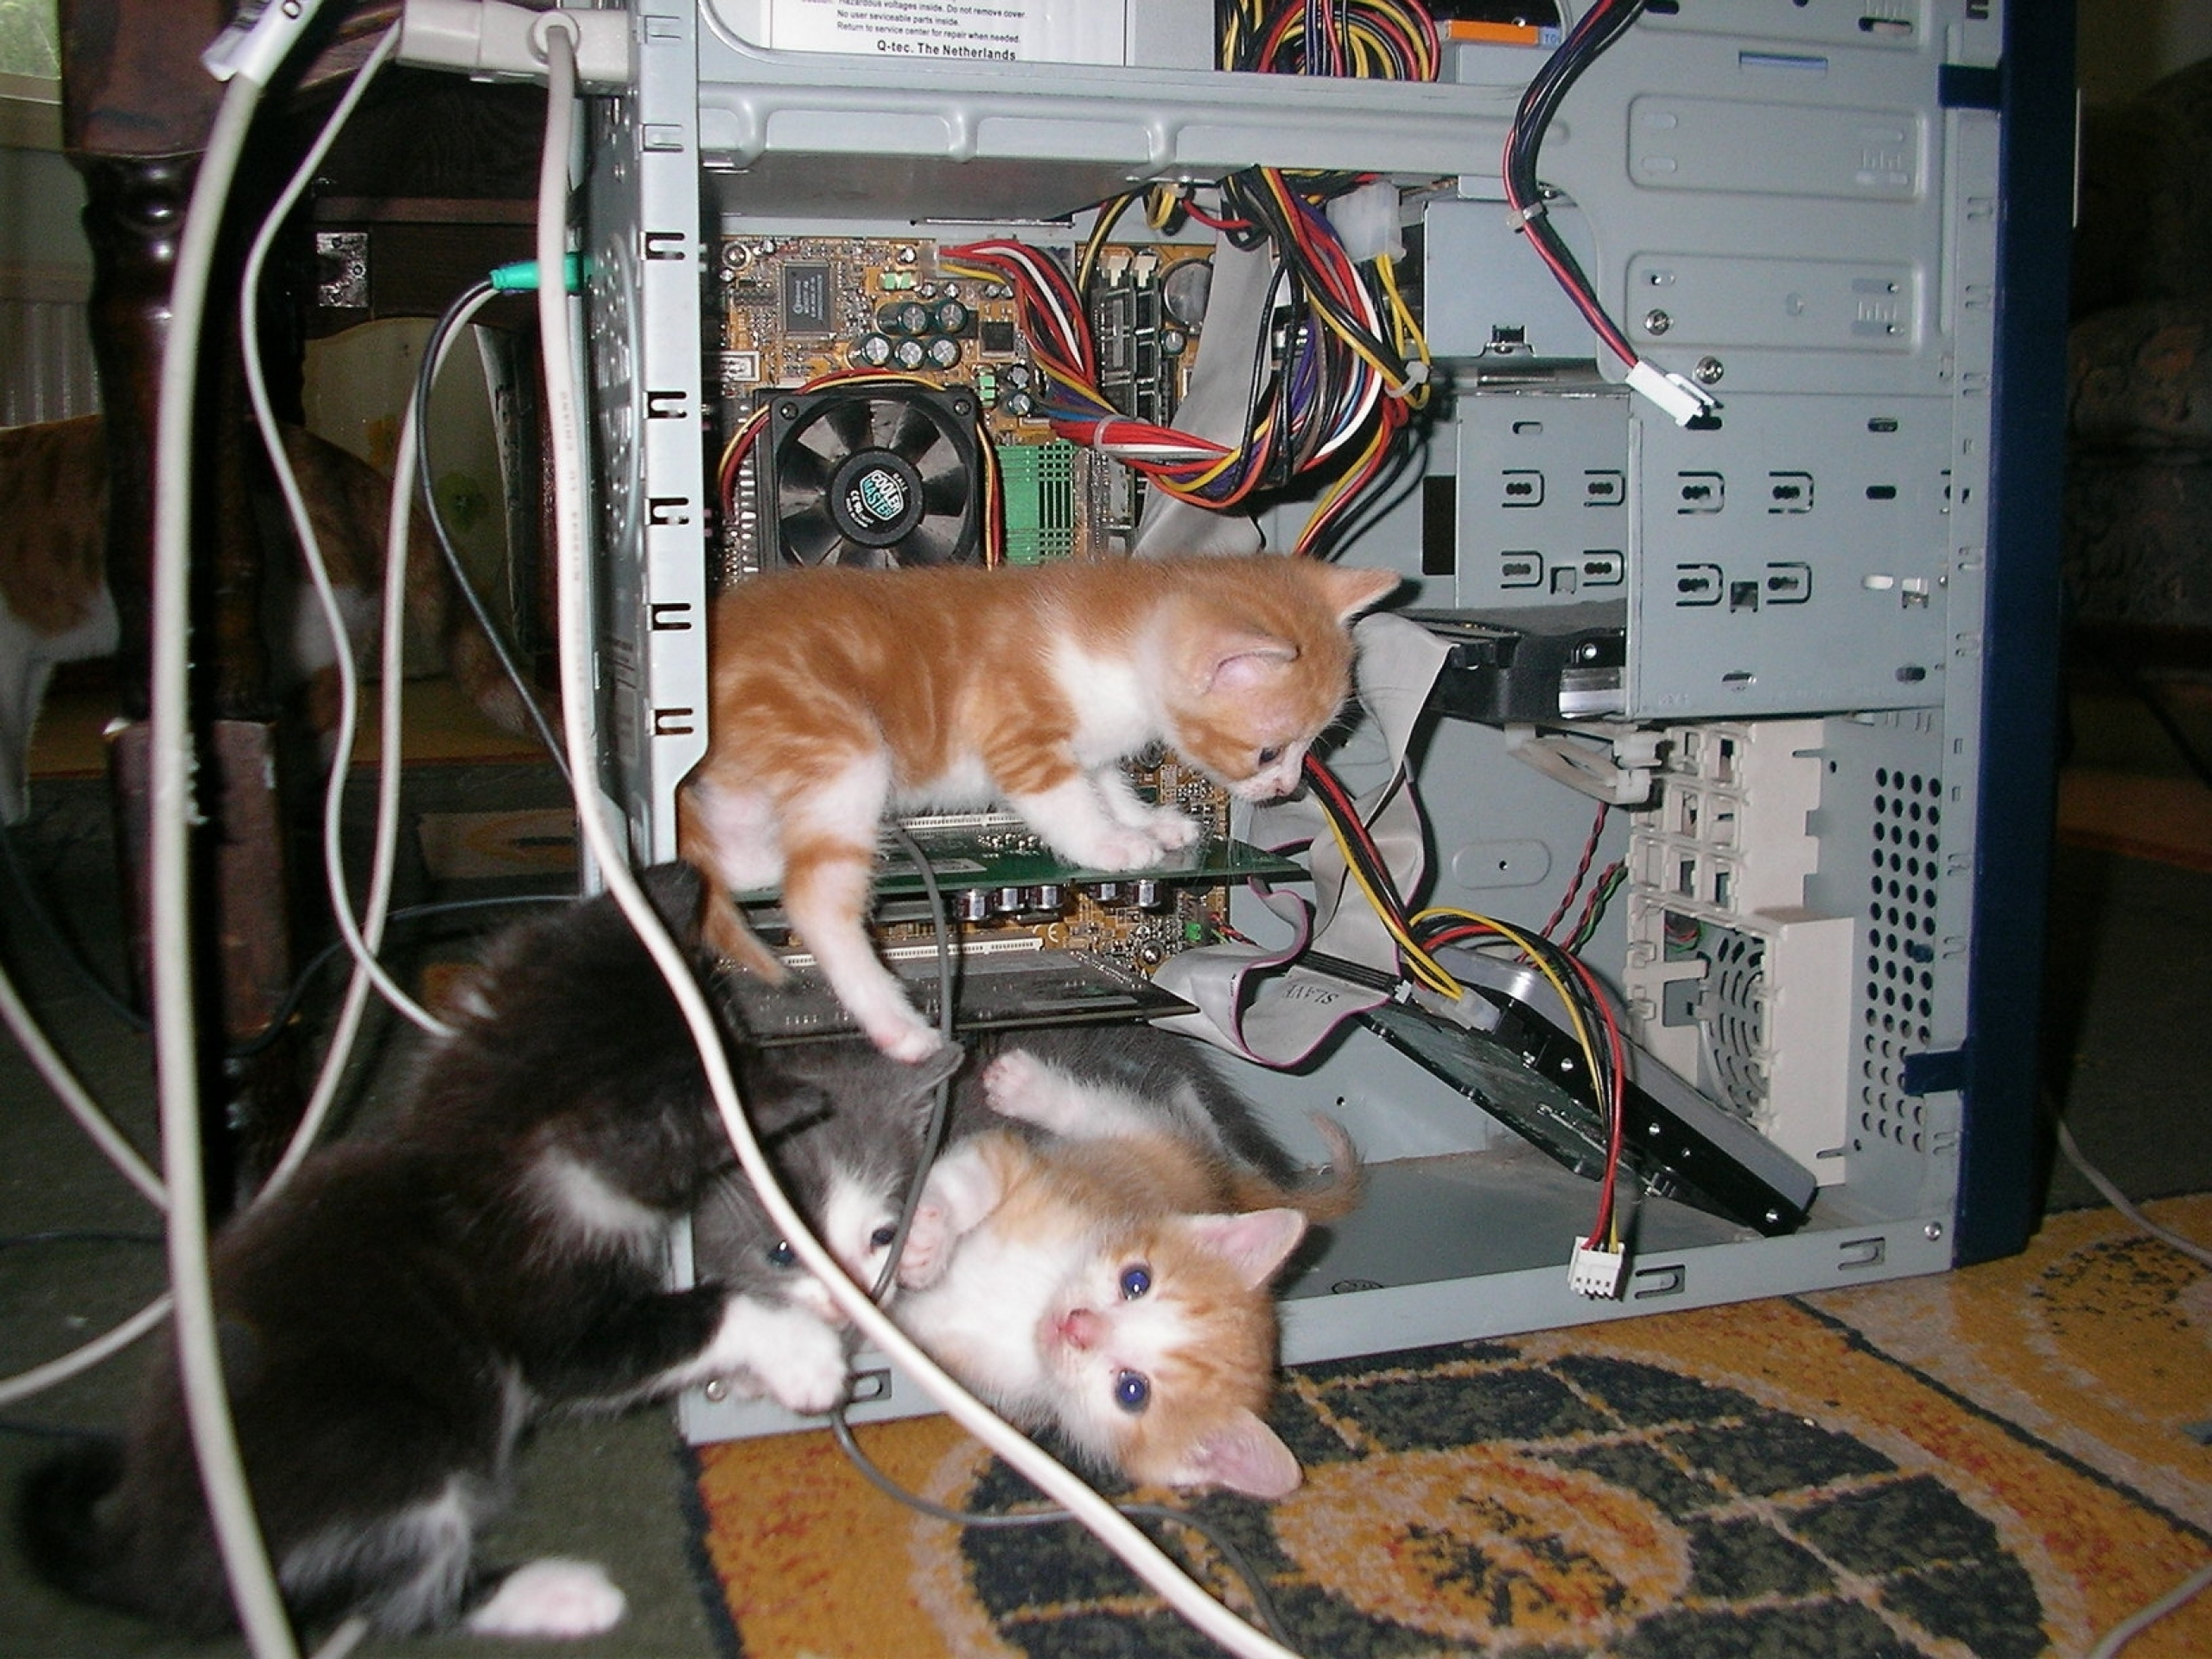
Wait, why?
No CVEs or Bug Bounties == !$
Pwn one, pwn them all
Operating systems are very hard to secure

Slide 11

Wait, why?
No CVEs or Bug Bounties == !$
Pwn one, pwn them all
Operating systems are very hard to secure
Do you have hardening standards in your env? Vendors shouldn’t get a free pass

Slide 12

Wait, why?
No CVEs or Bug Bounties == !$
Pwn one, pwn them all
Operating systems are very hard to secure
Do you have hardening standards in your env? Vendors shouldn’t get a free pass
Treasure is fun, but having a secure environment is even better

Slide 13

Sounds lame. Where’s my 0day?

Slide 14
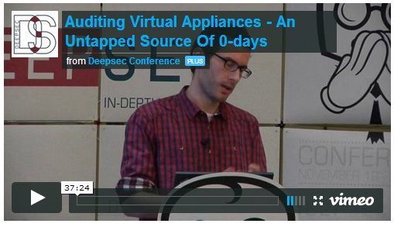
Sounds lame. Where’s my 0day?
DeepSec 2013 Stefan Viehböck
Best known for WPS algorithm vulns

Slide 15
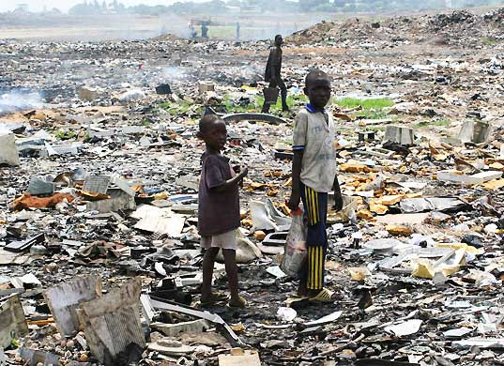
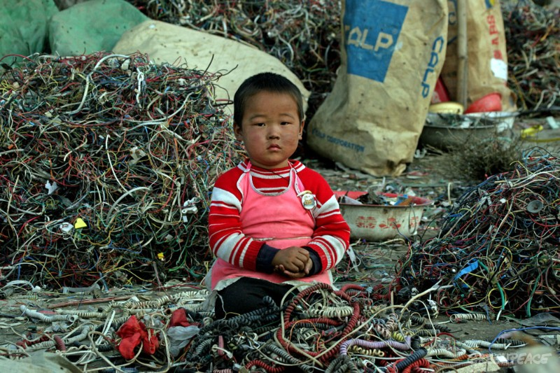
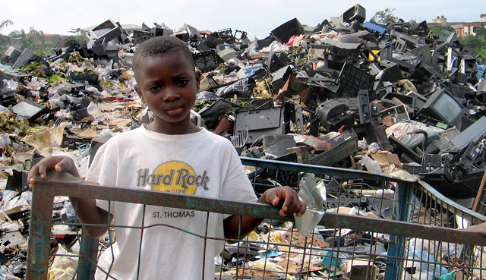
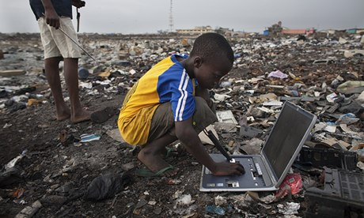
What kind of treasures can you dig up?
Mostly garbage

Slide 16
What kind of treasures can you dig up?
Usernames/passwords
Service account credentials
Cryptographic keys/seeds
Certificates ☺
Sensitive IPs/Company internals
Source code ☺
Internet history/cache/cookies
Internal configuration tools
Command history/juicy temp files
Vendor Backdoors ☺
?????wtf

Slide 17
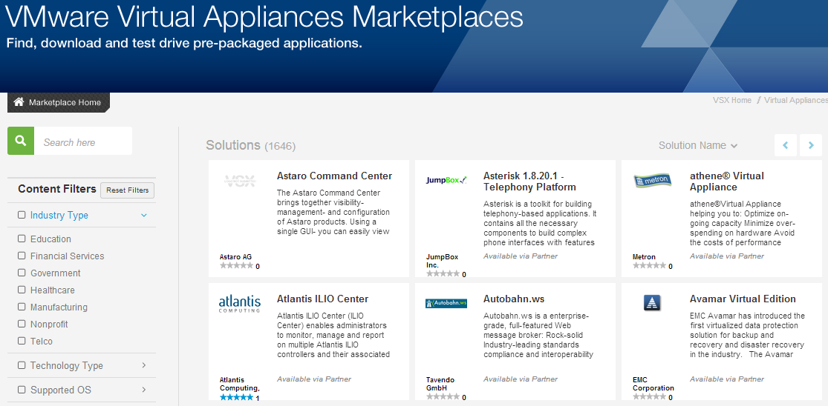
Who’s making these appliances?
Basically everyone

Slide 18
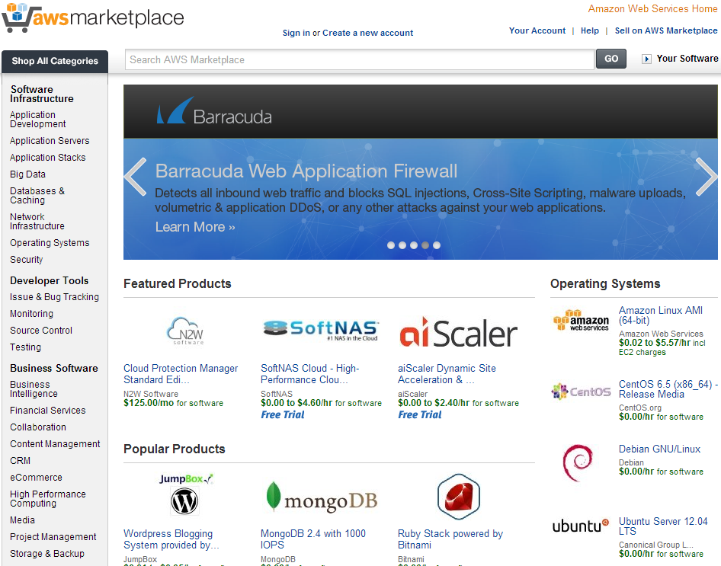
Who’s making these appliances?
Basically everyone, including cloud

Slide 19
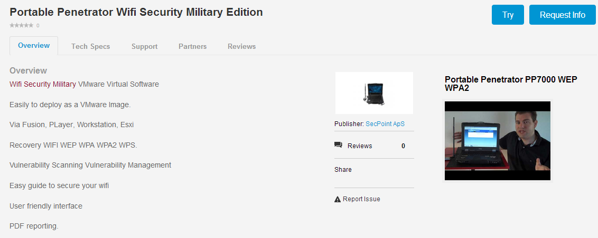
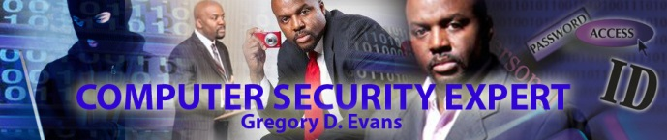
Who’s making these appliances?
Security vendors love them too

Slide 20












Who’s making these appliances?
Security vendors love them too

Slide 21
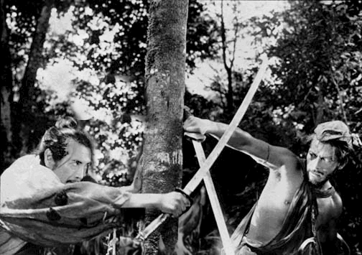
Methodology
All security products are dual use. –Dan Geer
Rashomon
1950

Slide 22

Methodology
½ Post Exploitation
Active attacks…err…um…’auditing’
Metasploit, Shell scripts, Linux-fu
What would you go after if you were an attacker with unlimited time and unlimited exfil capabilities?

Slide 23

Methodology
½ Forensics
- ‘Passive recovery’
- FTK, Autopsy, SIFT, Scalpel, Volatility
- You can rm –rf, but you can’t hide

Slide 24

Ready…Set…PWN!

Slide 25
#get r00t
If you own it, you can pwn it!
You have virtual ‘physical’ access
Single user mode root passwd reset
Konboot (old versions only)
Got sploitable vulns?
Privilege Escalation/SUID binaries http://pentestmonkey.net/tools/
http://pwnwiki.io/
Replace /etc/password with your own
If the disk is encrypted fear not! The keys _must_ be retrievable. See Stefan's tools ☺

Slide 26
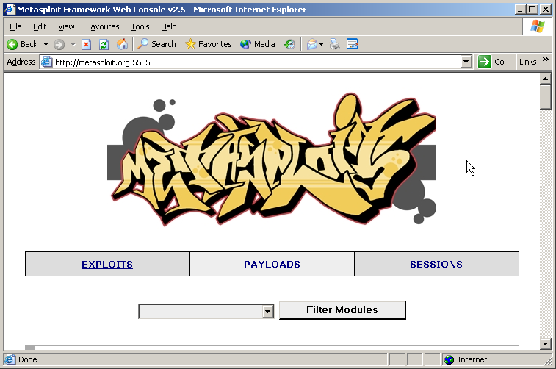

Lowest hanging fruits: Credz++
No need to reinvent the wheel, srsly.

Slide 27
Lowest hanging fruits: Credz++
post/linux/gather/ecryptfs_creds Gather eCryptfs Metadata
post/linux/gather/enum_configs Linux Gather Configurations
post/linux/gather/enum_protections Linux Gather Protection Enumeration
post/linux/gather/enum_system Linux Gather System and User Information
post/linux/gather/enum_users_history Linux Gather User History
post/linux/gather/enum_xchat Linux Gather XChat Enumeration
post/linux/gather/hashdump Linux Gather Dump Password Hashes for Linux Systems
post/linux/gather/mount_cifs_creds Linux Gather Saved mount.cifs/mount.smbfs Credentials
post/linux/gather/pptpd_chap_secrets Linux Gather PPTP VPN chap-secrets Credentials
post/multi/gather/fetchmailrc_creds UNIX Gather .fetchmailrc Credentials
post/multi/gather/filezilla_creds Multi Gather FileZilla FTP Client Credential Collection
post/multi/gather/firefox_credsMulti Gather Firefox Signon Credential Collection
post/multi/gather/gpg_credsMulti Gather GnuPG Credentials Collection
post/multi/gather/multi_commandMulti Gather Run Shell Command Resource File
post/multi/gather/netrc_credsUNIX Gather .netrc Credentials
post/multi/gather/pgpass_credsMulti Gather pgpass Credentials
post/multi/gather/pidgin_credMulti Gather Pidgin Instant Messenger Credential Collection
post/multi/gather/run_console_rc_file Multi Gather Run Console Resource File
post/multi/gather/skype_enumMulti Gather Skype User Data Enumeration
post/multi/gather/ssh_credsMulti Gather OpenSSH PKI Credentials Collection
post/multi/gather/thunderbird_creds Multi Gather Mozilla Thunderbird Signon Credential Collection
Automate with .rc Resource Scripts

Slide 28
Known files of interest
/home/*/.ssh/authorized_keys
/home/*/.ssh/known_hosts
/home/*/.hist*
/root/*
/etc/ssh/ssh_host_*_key_files
Sudo history: /var/log/auth.log, sudo.log
Check persistence spots
/etc/inittab /etc/inet.d /etc/rc.d, /etc/init, /etc/init.conf, /etc/cron*, /var/spool/cron*

Slide 29
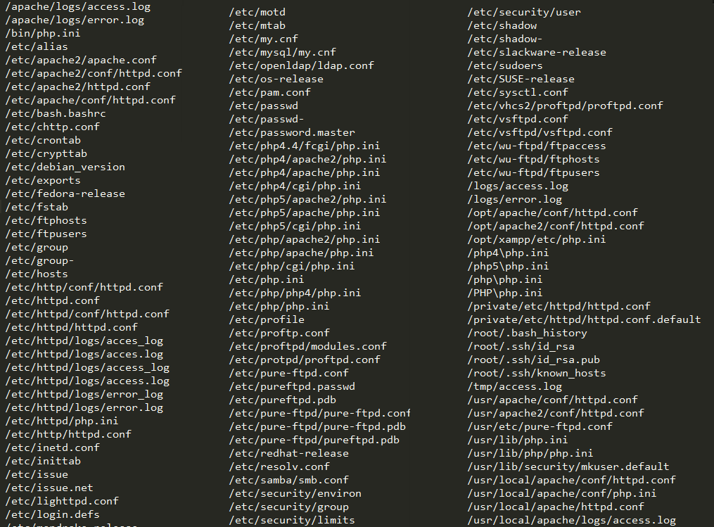
Known files of interest
Hundreds of potentially interesting files: http://pwnwiki.io/presence/linux/pillage.lst

Slide 30
Known files of interest
Search through files with a recursive case-insensitive
grep -i -r password /DIR

Slide 31

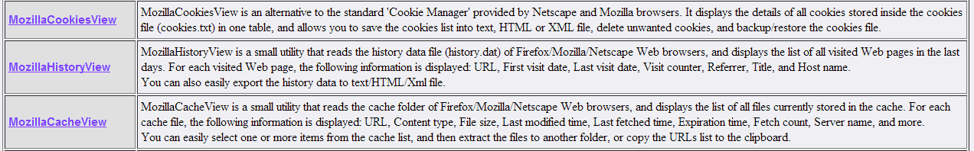
Known files of interest
How about browser artifacts?
$HOME/.mozilla/firefox/*.default
cookies, cache, history, saved passwords, sqlite dbs

Slide 32
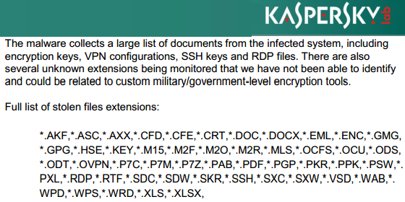
Unknown files of interest
Careto AKA The Mask
We can do better: *.BAT, *.CER, *.CERT, *.CONF, *.CSR, *.DSR, *.KDB, *.KDBX, *.INI, *.PEM, *.PKCS12, *.PFX, *.P12, *.PPT, *.PPTX, *.VNC
Don’t forget to check metadata

Slide 33
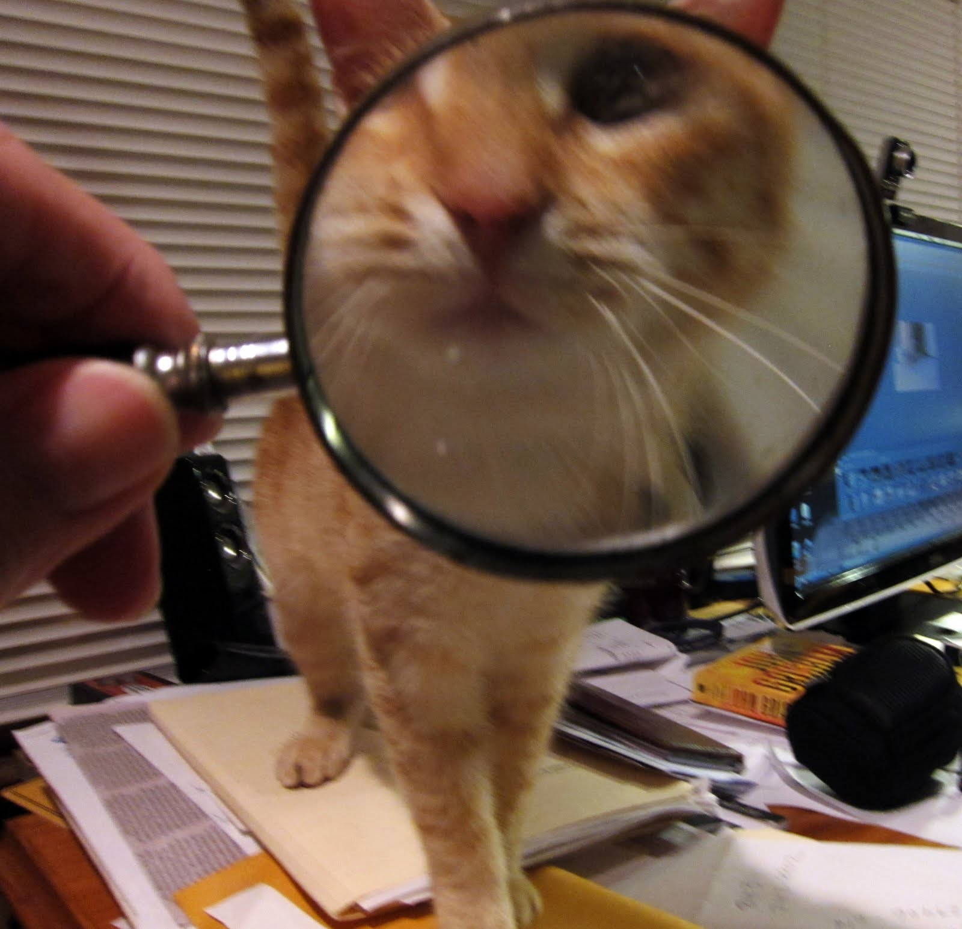
Faux-rensics

Slide 34

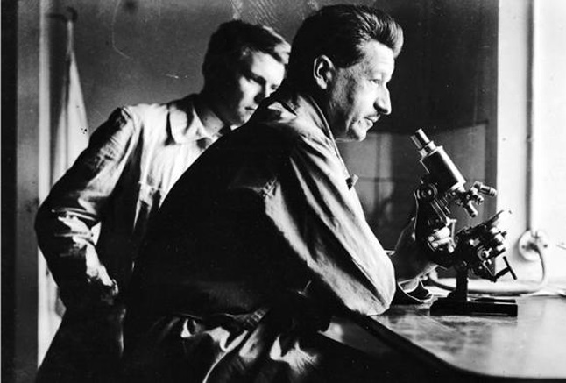

Locard’s Exchange Principal
With contact between two items, there will be an exchange.

Slide 35
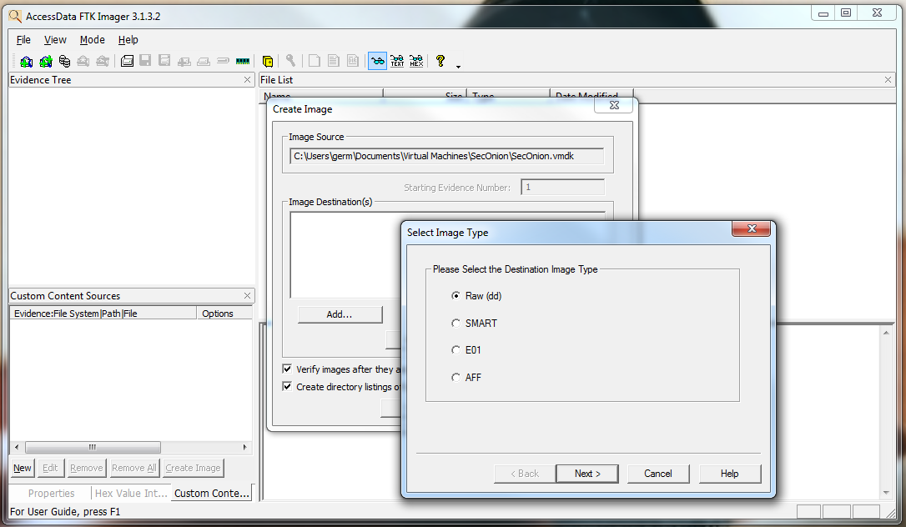
Capture a raw image (dd)
AccessData FTK Imager

Slide 36

Capture a raw image (dd)
Grep for strings in unallocated space to find deleted files

Slide 37
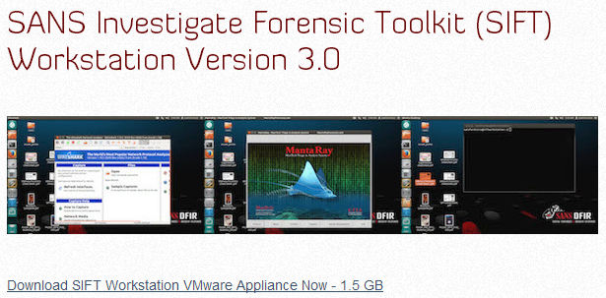
SIFT Virtual Appliance

Slide 38

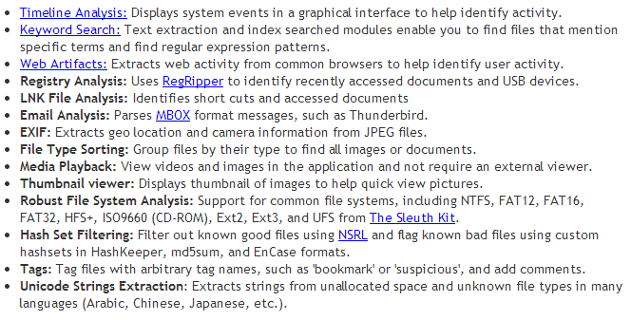
Autopsy

Slide 39
Faux-rensics
Recovering sensitive files that have been _insecurely_ deleted
Oftentimes the files is only MARKED as deleted; actual data bytes\inodes are NOT overwritten
Carving: reconstructing files by scanning the raw bytes of the disk and reassembling them
Usually done by checking the header (first four bytes of the file) and footer
Filesystem independent
Recovering fragmented files can be difficult

Slide 40
Carving
http://www.forensicswiki.org/wiki/Tools:Data_Recovery#Carving
Plenty of options
Scalpel
High performance
Based on Foremost (Developed by the Air Force, endorsed by Hal Pomeranz)
Support for massively-threaded execution on Graphics Processing Units (GPUs)
Regular expression support for headers/footers

Slide 41
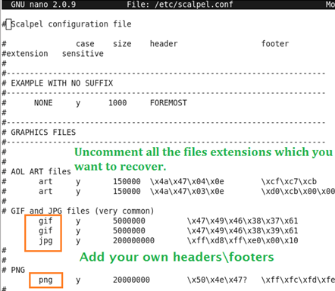
Carving
Default .conf accounts for ~200 file types

Slide 42
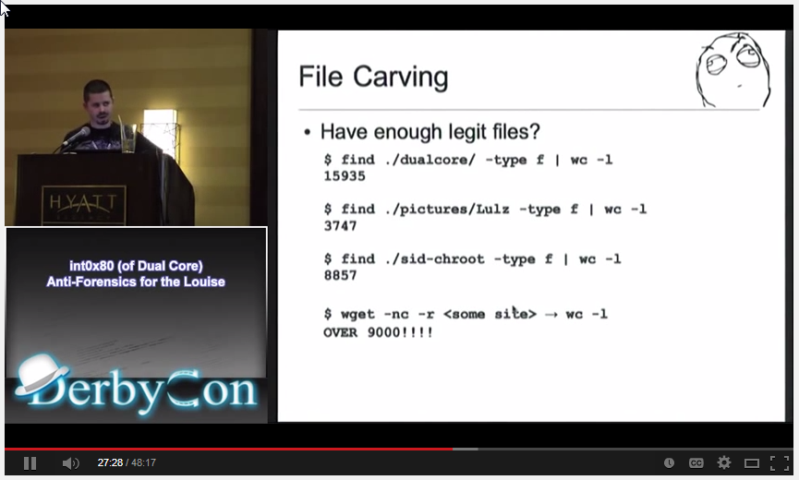
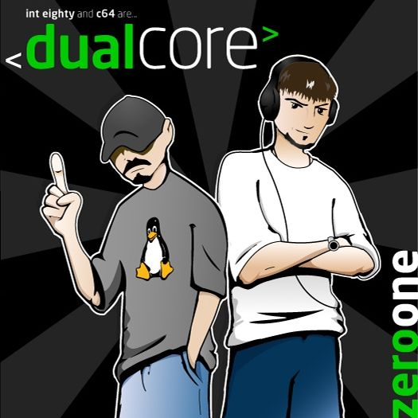
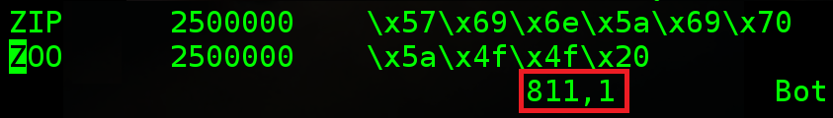
Carving
int0x80
Our .conf accounts for 800+ file types ☺

Slide 43

Carving…when I get that feelin’

Slide 44
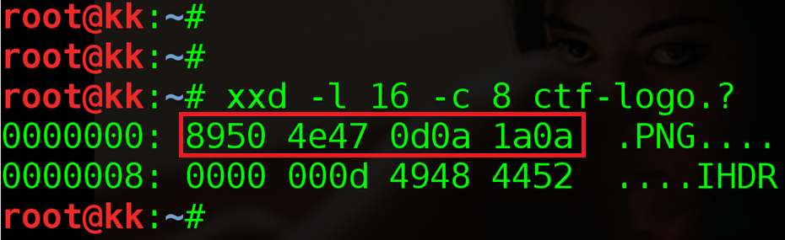
Carving…Hex Appeal

Slide 45
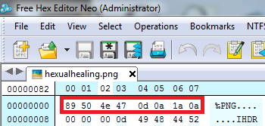
Carving

Slide 46
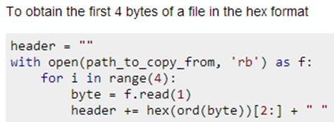
Carving

Slide 47
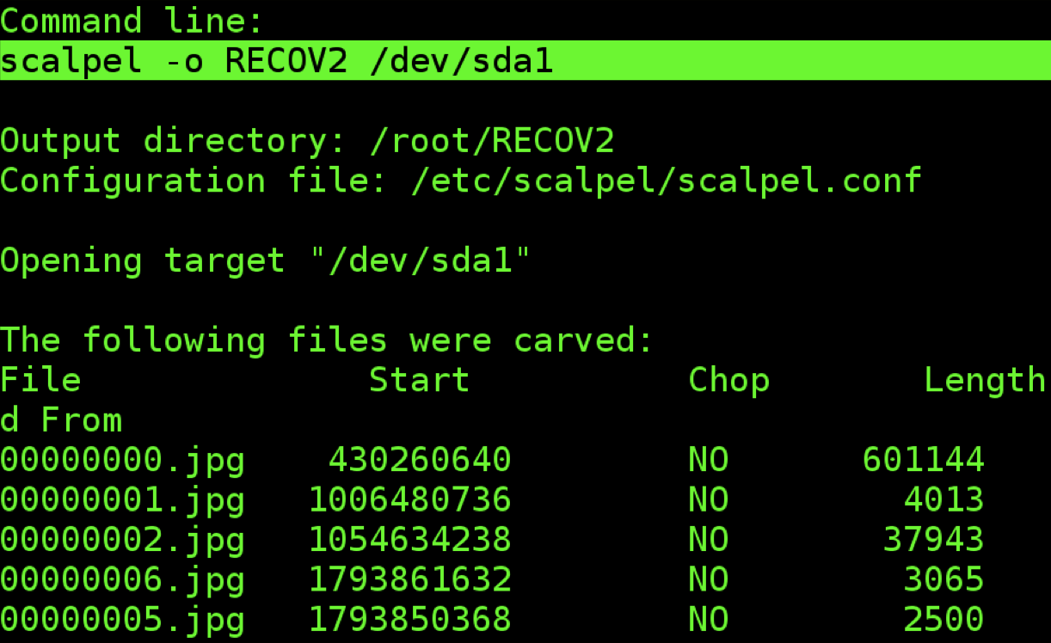
Carving

Slide 48

Memory Analysis

Slide 49

Memory Analysis
Supports Linux and server architectures
Open source and hacker friendly

Slide 50
Memory Analysis
Focusing on virtual Linux servers has +-
-There is far more support for Windows
-Individual profiles must be built per arch
+Acquiring memory is dead simple
+Volalitly natively supports .vmem
+Once a profile is created, it can be reused
Greater Work == Greater Reward

Slide 51

Volatility Profile Creation
On the platform to be analyzed:
Download Volatility source code
Create vtypes (kerenl’s data structure)
Get kernel symbols (System.map)
Compile profile into zip

Slide 52
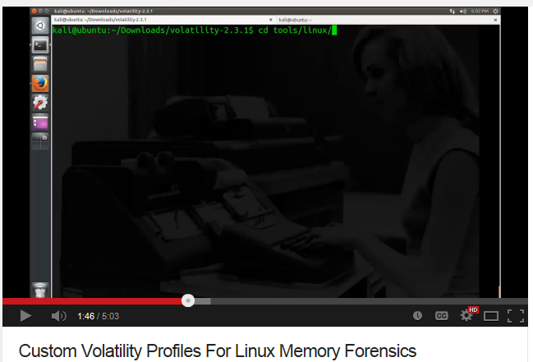
Volatility Profile Creation

Slide 53
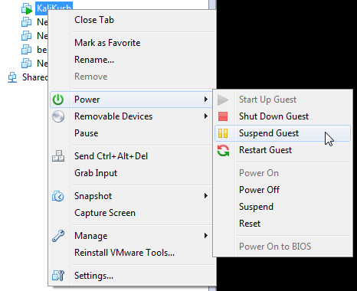
Acquire Memory

Slide 54
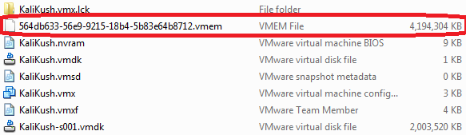
Acquire Memory

Slide 55

Memory Analysis
Use new profile + vmem + plugins
????
PROFIT
$ python vol.py -f /root/Ubuntu.vmem --profile=Ubuntu1404x64.zip linux_check_creds

Slide 56
Plugins
linux_bash Recover bash history from bash process memory
linux_check_creds Checks if any processes are sharing credential structures
linux_dump_map Writes selected memory mappings to disk
linux_find_file Recovers tmpfs filesystems from memory
linux_memmap Dumps the memory map for linux tasks

Slide 57
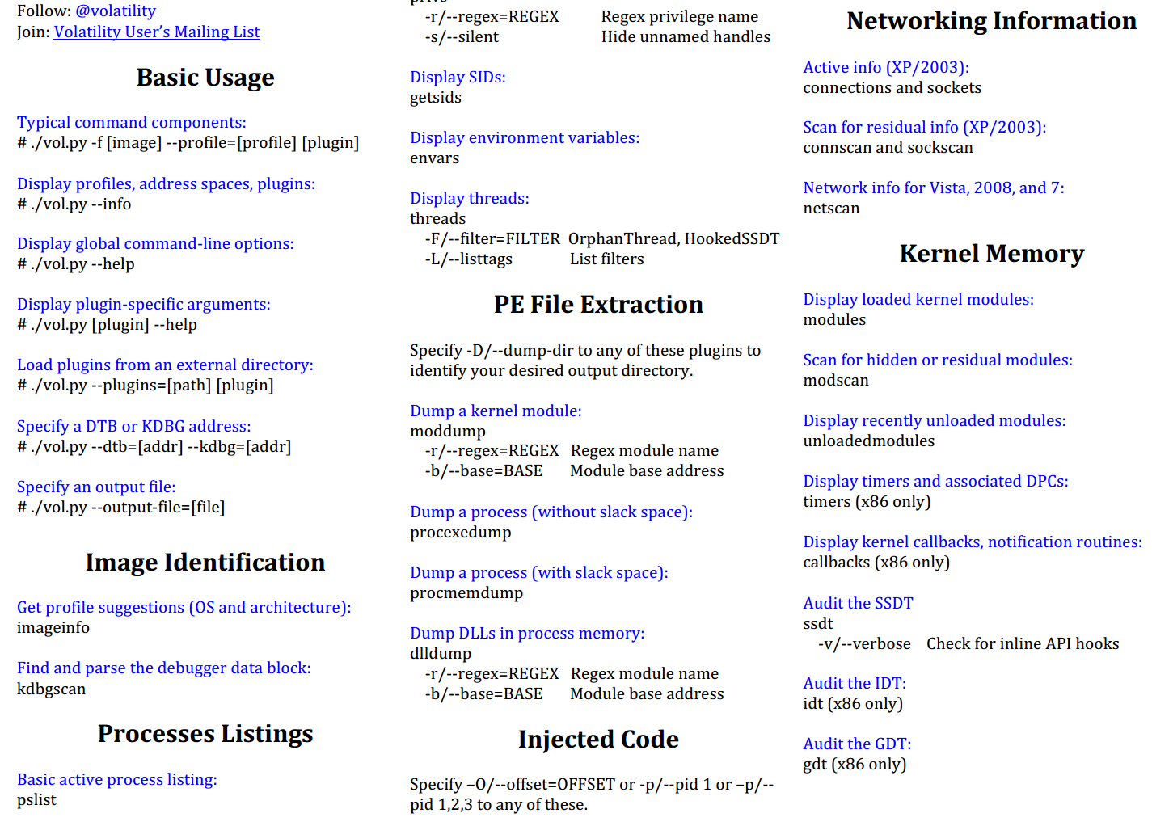
Cheat when possible

Slide 58
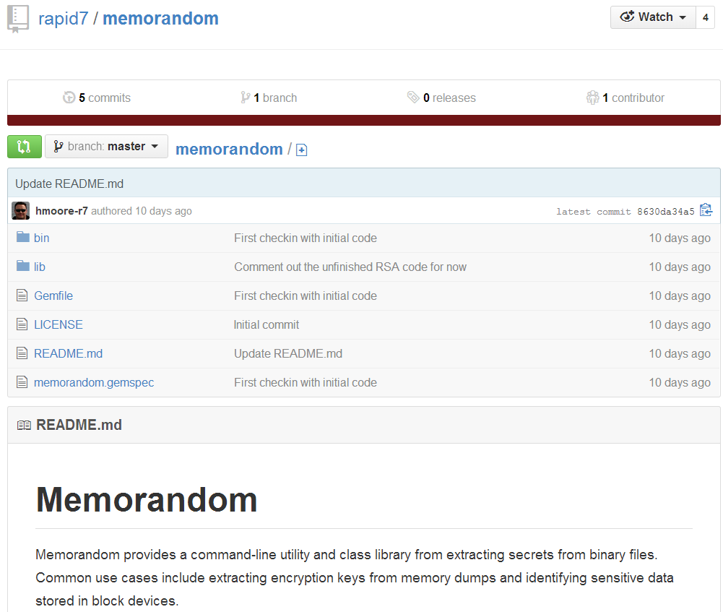
Don’t reinvent the wheel

Slide 59
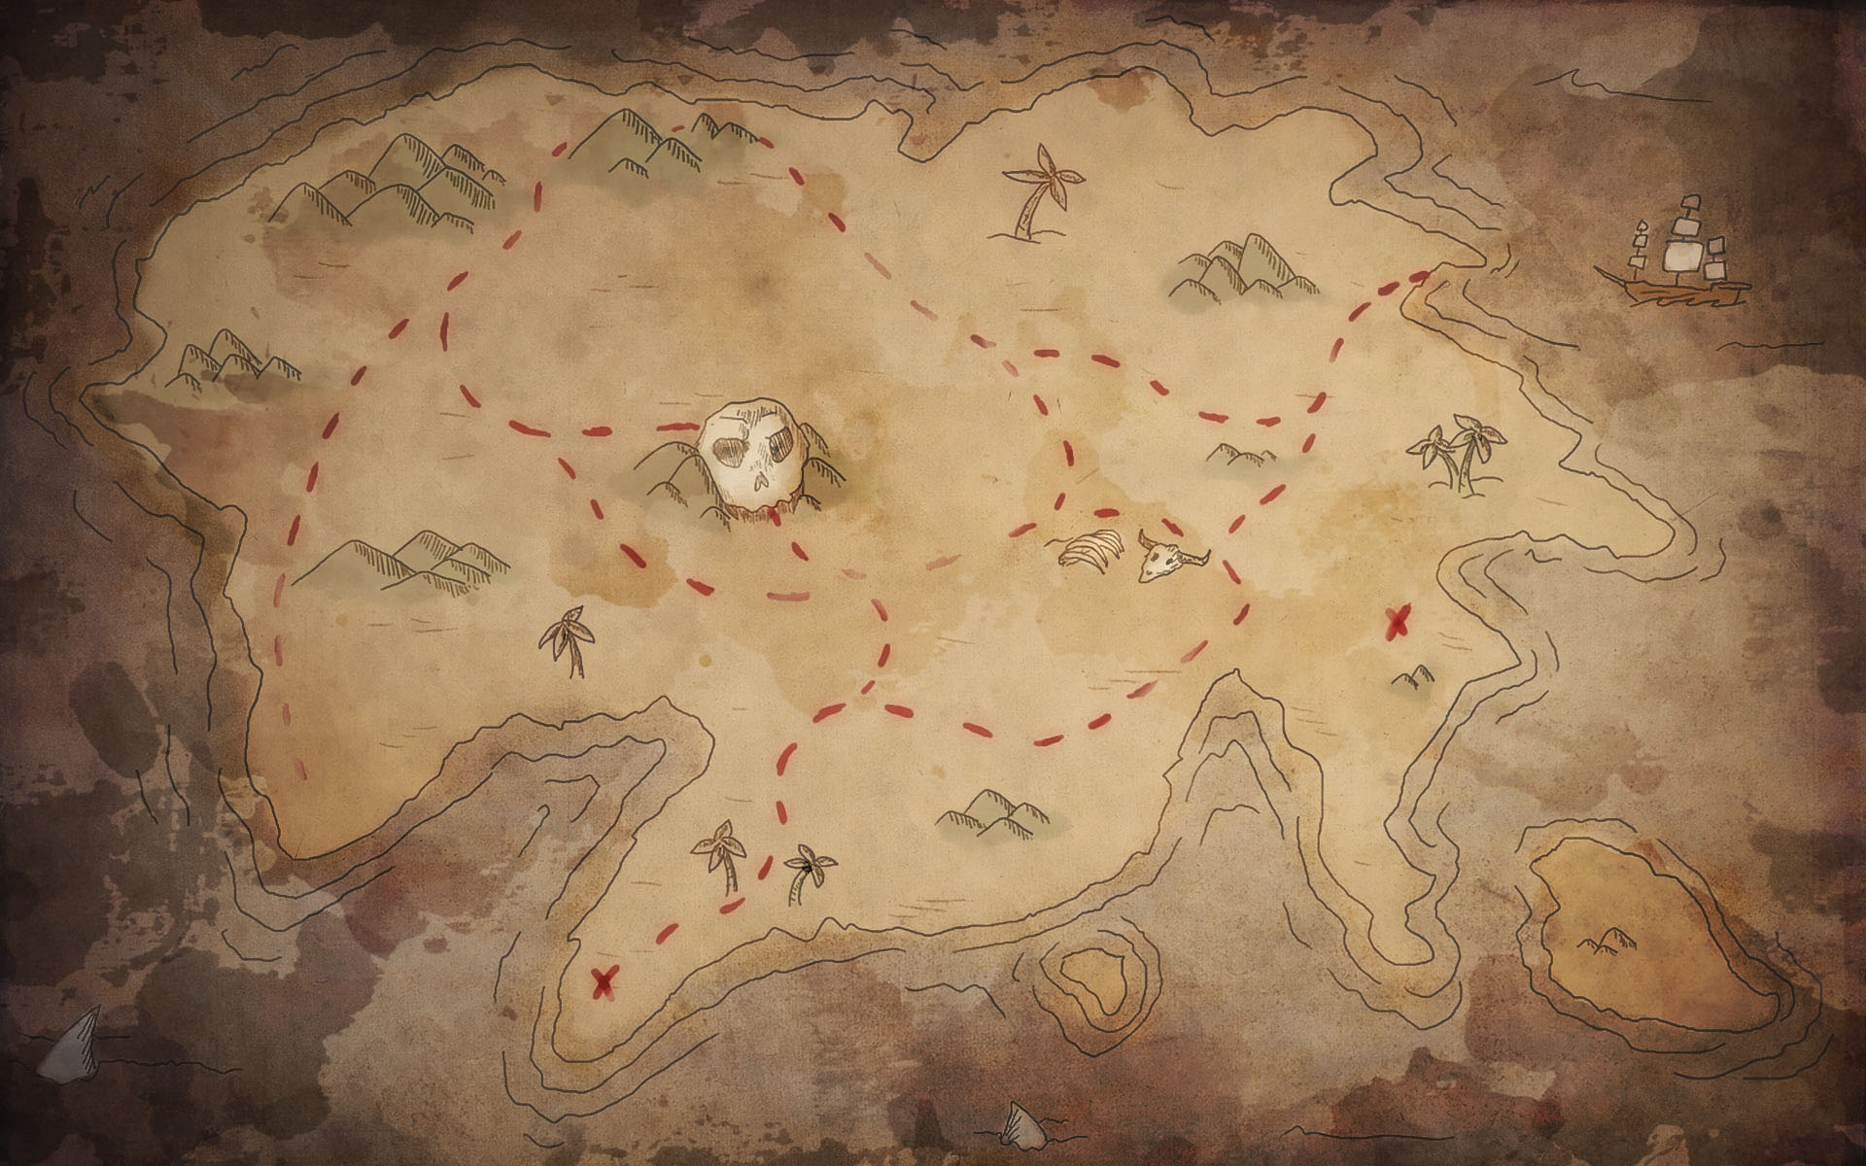
Putting the pieces together
Gaining Root
Post Exploitation
Pillaging Files
Faux-rensics
Volatile Memory Analysis
Carving
Obtain Credz
Hexual Healing

Slide 60
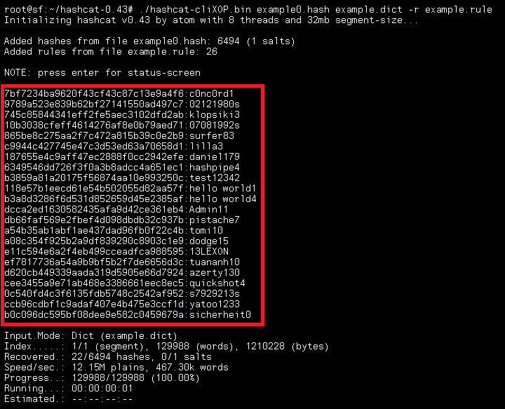

Putting the pieces together

Slide 61
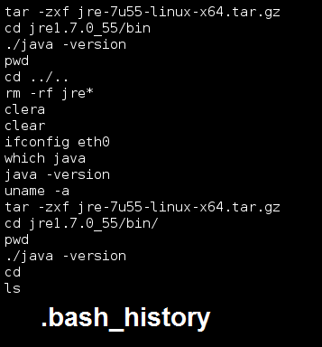
Putting the pieces together

Slide 62
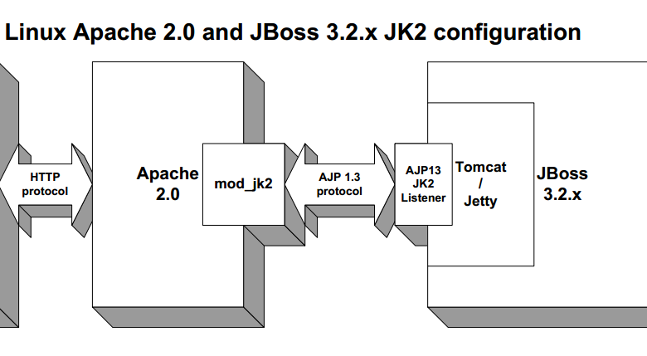
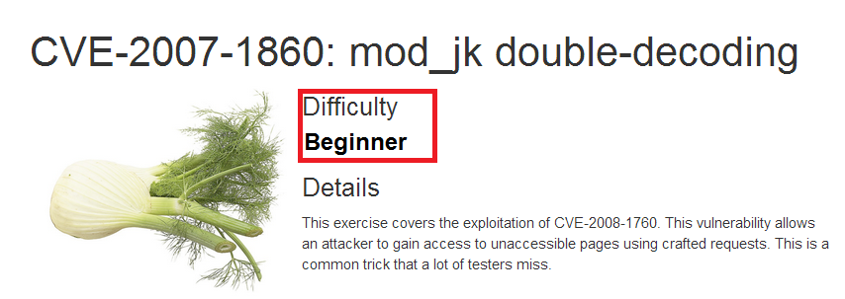
Putting the pieces together

Slide 63
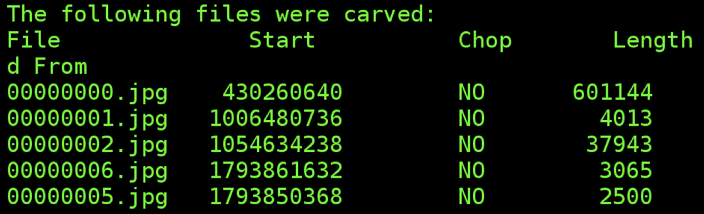
Putting the pieces together

Slide 64
Putting the pieces together

Slide 65
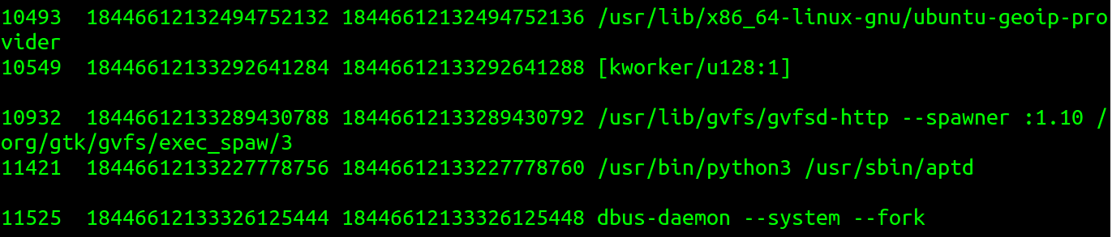
Putting the pieces together

Slide 66
Putting the pieces together

Slide 67
Putting the pieces together

Slide 68

Bask in your treasures!

Slide 69

Bask in your treasures! 210 Style

Slide 70
C.Y.A.
If you release a virtual appliance or distro, have some manners and clean up after yourself!
Use tools like: wipe, BleachBit (deletes inodes)
sudo aptitude install secure-delete
srm (Secure remove)
smem (Secure memory wiper)
sfill (Secure free space wiper)
sswap (Secure swap wiper)
srm (Secure remove)
Compartmentalize. Minimize what you bring into the virtual environment.
When you do find something, *Hold the vendor accountable for fixing it!*

Slide 71
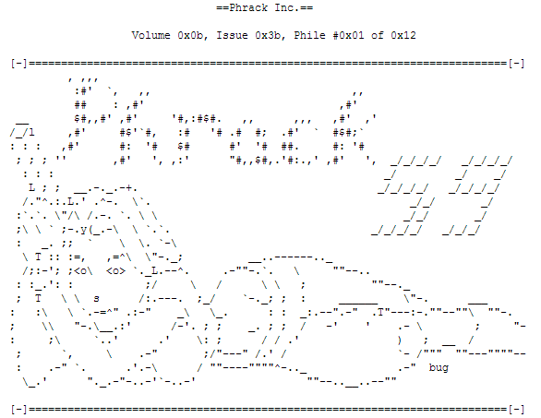
C.Y.A.

Slide 72
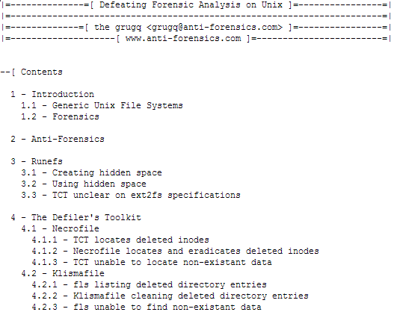
C.Y.A.

Slide 73

C.Y.A.

Slide 74

Contest Time!

Slide 75

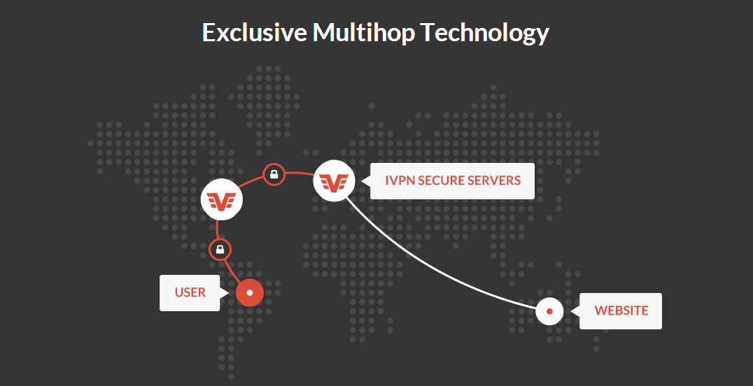
WinRar!

Slide 76

Questions?

Slide 77
References
http://blog.deepsec.net/?p=1762
https://solutionexchange.vmware.com/store/category_groups/virtual-appliances
http://pwnwiki.io/
http://digital-forensics.sans.org/community/downloads
https://github.com/sleuthkit/scalpel
http://www.phrack.org/issues.html?issue=59&id=6&mode=txt
https://www.securelist.com/en/downloads/vlpdfs/unveilingthemask_v1.0.pdf
http://www.forensicswiki.org/

Slide 78
References
http://digital-forensics.sans.org/community/downloads
int0x80 (of Dual Core) . Anti-Forensics for the Louisville Derbycon 2011 https://www.youtube.com/watch?v=iK5cGUStklw
https://github.com/sleuthkit/scalpel
https://hakshop.myshopify.com/
https://code.google.com/p/volatility/
http://science.howstuffworks.com/locards-exchange-principle.htm
http://www.metasploit.com/
http://www.nirsoft.net/
http://pentestmonkey.net/
http://www.youtube.com/watch?v=_KiyTvojl3I

Slide 79

Thank you BSides San Antonio!

Slide 80

Happy Mother’s Day!
Remember, you’re the reason she drinks ☺

Slide 81

spoolz
jg@hp.com
xgermx@gmail.com
http://JeremyGalloway.com
http://EcstaticSec.tumblr.com

